Slide 1
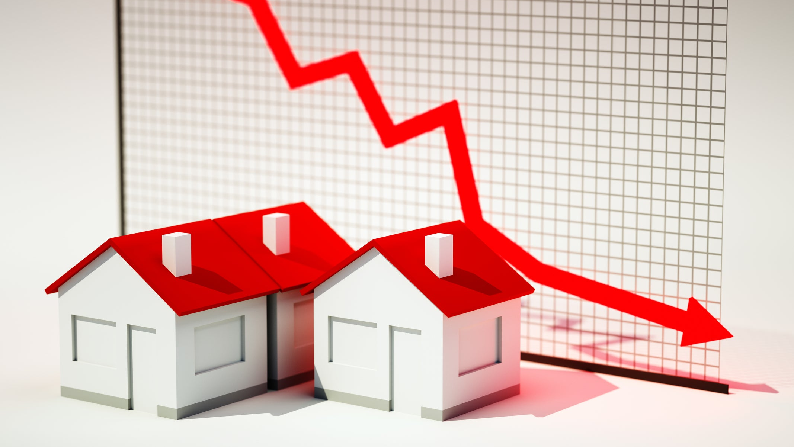
Classify social class by Real Estate
ABDULAZIZ Wali

Slide 2

Back Story

Slide 3
Process
Scrapping
EDA
Modeling
Classification

Slide 4
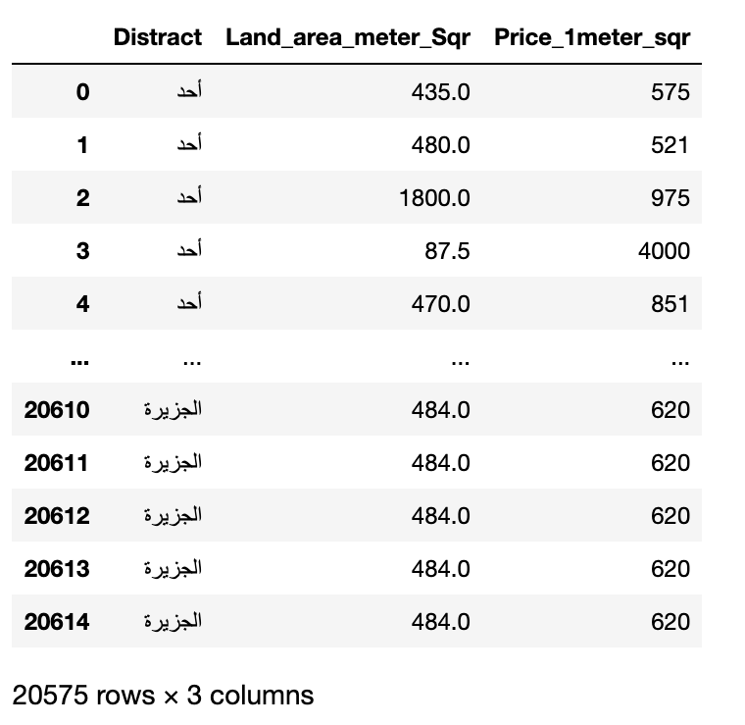
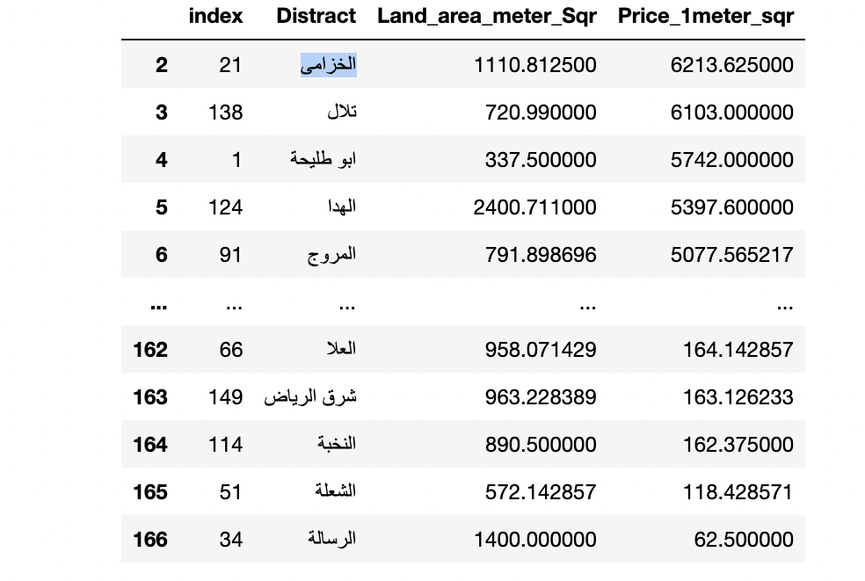
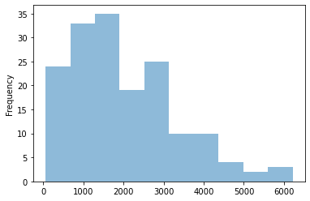
OUR DATASET

Slide 5
Classification
Greater than 2778
Between 1796 and 2778
Between 486 and 1796
Less 486

Slide 6
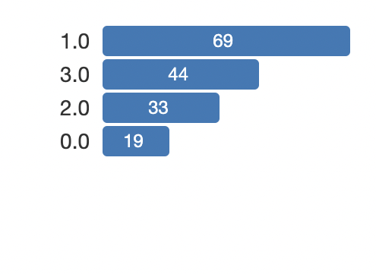
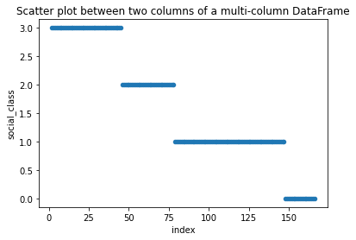
Distribution

Slide 7
Model Selection
Random Forest Classifier
Accuracy on Validation set 0.96
Accuracy on training set: 1.0
Log Regression Classifier
Validation Score 0.93
Accuracy on training set: 1.0
Knn Classifier
Validation Score 0.93
Accuracy on training set: 0.95

Slide 8
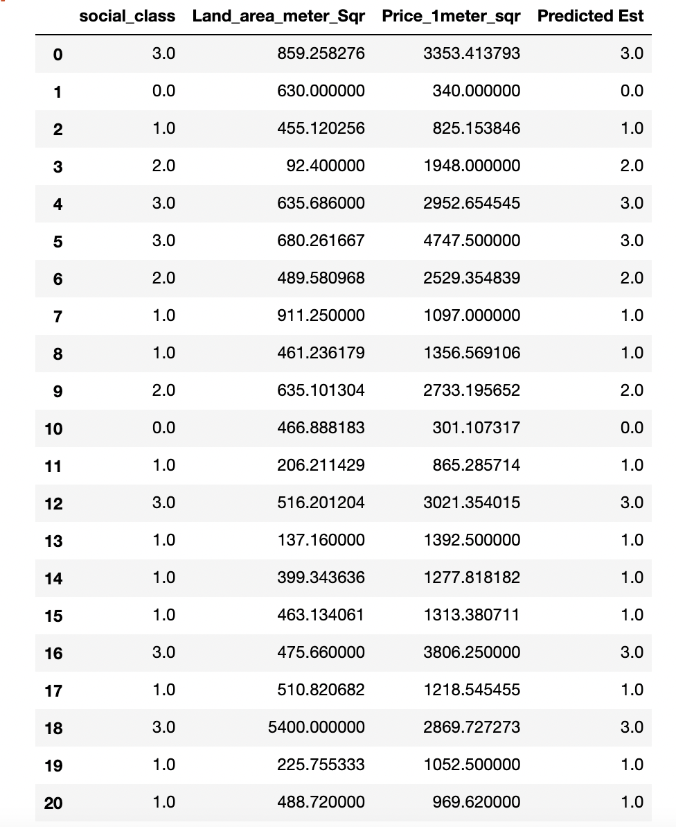
Our Prediction

Slide 9
Conclusion
Random Forest can be a helpful in our case.
Real estate Prices depend on the location

Slide 10

Thank You

